Slide 1
CSE 3411 System Analysis and Design (SAD) Spring 2024
Dr. Suman Ahmmed
Sumayra Islam
Abtahi Ahmed

Slide 2
SDLC Steps
Idea Generation (optional)
Planning
System Information/Requirement Gathering
Analysis
Design
Development/Construction/Coding
Testing
Deployment
Post–Implementation & Maintenance

Slide 3


Slide 4
UI Design
User Interface is the front-end application view to which the user interacts to use the software.
Can be graphical user interface or other forms, such as voice-controlled interfaces or command-line interfaces.

Slide 5
Steps of UI Design
Planning – Understand the customer’s requirements; Benchmark Analysis; Set the theme and navigation
Prototyping & Sketching – Use tools such as Figma, Canva, Proto.io, etc, to create rough demo
Optimization – Investigate and analyze to make the prototypes more efficient
Implement – Finalize the prototype based on feedback and implement

Slide 6
Rules of UI Diagram
There are quite a few set of rules created by different people that address the best practices and requirements of UI Design, such as Three Golden Rules, Shneiderman’s Eight Golden Rules, Norman’s Design Principles, etc.

Slide 7
Three Golden Rules of UI Design
Place Users In Control 1.1. Modeless 1.2. Flexibility 1.3. Interruptible 1.4. Helpful 1.5. Forgiving
1.6. Navigable 1.7. Accessible 1.8. Facilitative 1.9. Preferences 1.10. Interactive

Slide 8
Three Golden Rules of UI Design
2. Reduce Users’ Memory Load 2.1. Relieve short-term memory 2.2. Rely on recognition, not recall 2.3. Provide visual cues 2.4. Forgiving 2.5. Frequency
2.6. Promote an object-action syntax 2.7. Use real-world metaphors 2.8. User progressive disclosure 2.9. Organize

Slide 9
Three Golden Rules of UI Design
3. Make the interface consistent 3.1. Continuity 3.2. Maintain consistency within and across products 3.3. Keep interaction results the same 3.4. Provide aesthetic appeal and integrity 3.5. Encourage exploration

Slide 10

Shneiderman’s Eight Golden Rules of UI Design
1. Strive For Consistency Same design patterns and sequences of actions in similar situations throughout an application’s workflows.
Identical terminology should be used in prompts, menus, and help screens;
Consistent colors, layout, capitalization, fonts, etc, should be employed throughout.

Slide 11
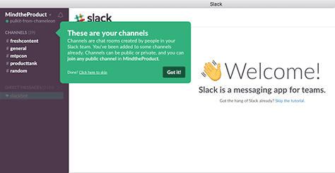
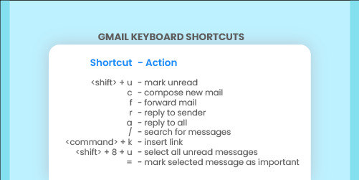
Shneiderman’s Eight Golden Rules of UI Design
2. Seek Universal Usability A user-interface design is good only when all new users can find their way through the application without any problems and can quickly achieve their goals.
Users may be of different ages or from different cultures.
Can be done by the use of navigation tips and shortcuts.

Slide 12
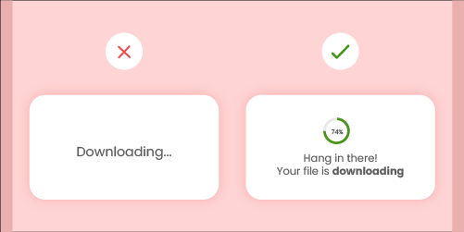
Shneiderman’s Eight Golden Rules of UI Design
3. Offer Informative Feedback The design should always keep users informed about what is going on. Don’t keep the users guessing — tell them what’s happening.
When users know the current system status, they learn the outcome of their prior interactions and determine next steps.
Creates trust in the product and the brand.

Slide 13

Shneiderman’s Eight Golden Rules of UI Design
4. Design Dialog To Yield Closure Make sure that the user sees an appropriate message or maybe even receives some kind of reward at the end of a process.
Gives users a sense of satisfaction on completing the task.

Slide 14
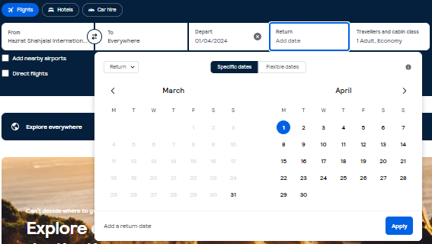
Shneiderman’s Eight Golden Rules of UI Design
5. Prevent Errors
Guide your users through an entire process, smoothly and seamlessly.
Good error messages are important, but the best designs carefully prevent problems from occurring in the first place.

Slide 15
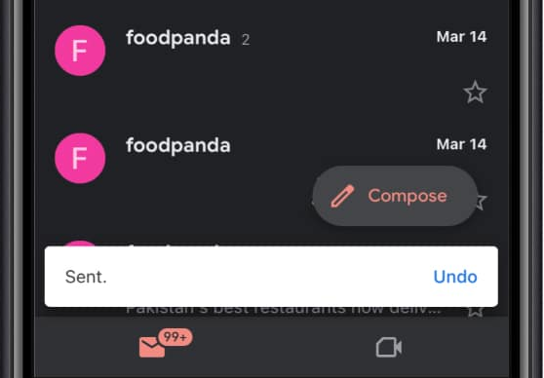
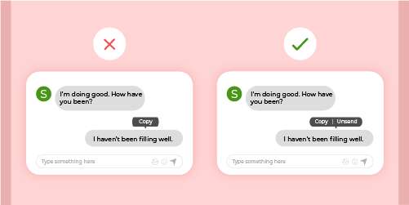
Shneiderman’s Eight Golden Rules of UI Design
6. Permit Easy Reversal Of Actions
Relieves anxiety, since the user knows that errors can be undone; it thus encourages exploration of unfamiliar options.
Ability to cancel a current action or go back and undo their actions.
(Back,Cancel,Close,Undo,Redo,etc)

Slide 16
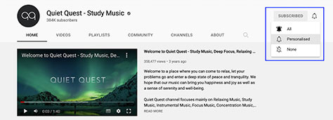
Shneiderman’s Eight Golden Rules of UI Design
7. Let The Users Be In Control
Experienced users strongly desire the sense that they are in charge of the interface and that the interface responds to their actions.
Give users the ability to use your application in whatever way they want to use it and enable them to customize the user interface to suit their needs.

Slide 17
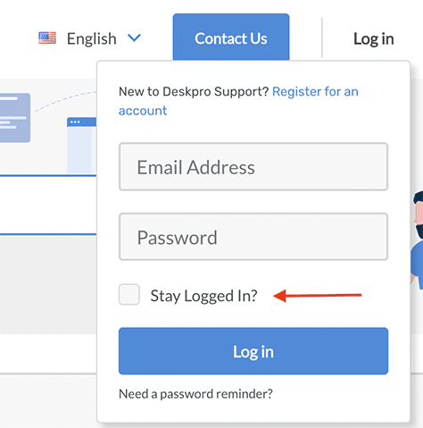
Shneiderman’s Eight Golden Rules of UI Design
8. Reduce Short-Term Memory Load
Don’t make your users remember any information except what’s absolutely necessary.
Recognizing something is easier than remembering it.
Use iconography and other visual aids such as themed coloring and consistent placement of items.
Avoid requiring overly long sequences of actions.

Slide 18
Shneiderman’s Eight Golden Rules of UI Design
8. Reduce Short-Term Memory Load
The rule of thumb is that people can remember “seven plus or minus two chunks” of information

Slide 19
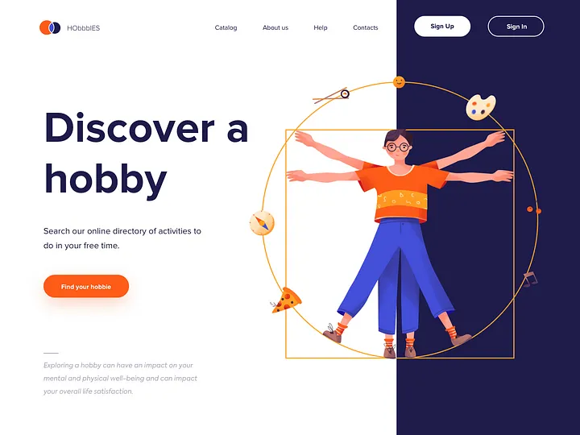
Norman’s Seven Fundamental Design Principles
1. Discoverability
Determine the current state of the system and discover which actions are possible at the moment.

Slide 20
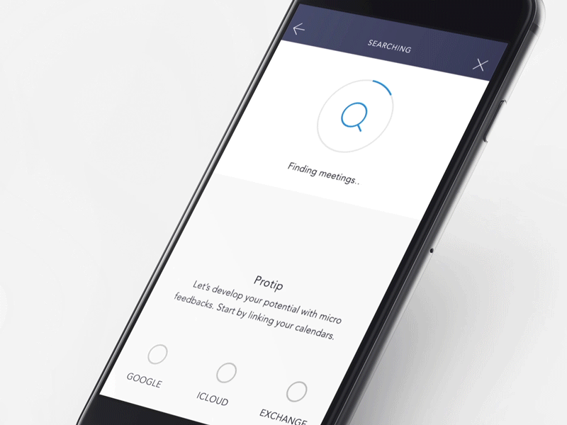
Norman’s Seven Fundamental Design Principles
2. Feedback
Let the user know that the system is working on their request.

Slide 21
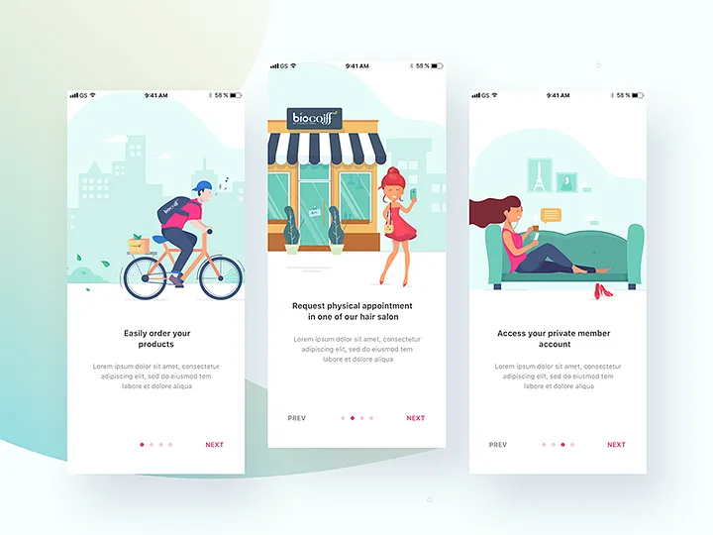
Norman’s Seven Fundamental Design Principles
3. Conceptual Model
Provide a simple and helpful explanation of how something works.

Slide 22

Norman’s Seven Fundamental Design Principles
4. Affordance
An object’s perceived action and its properties should match.

Slide 23
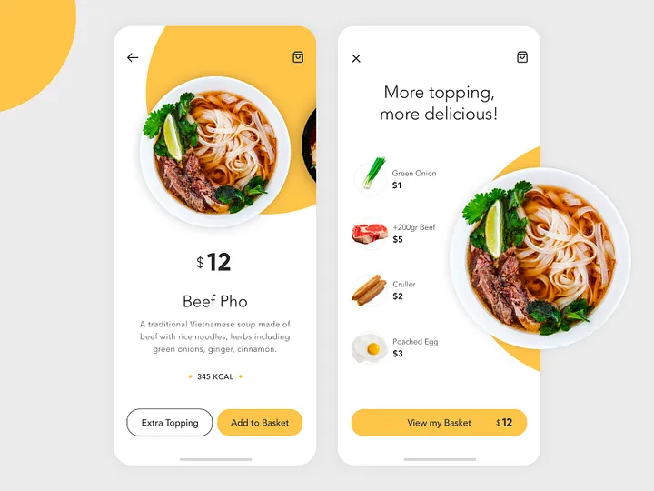
Norman’s Seven Fundamental Design Principles
5. Signifiers
Communicates where the action should take place.

Slide 24
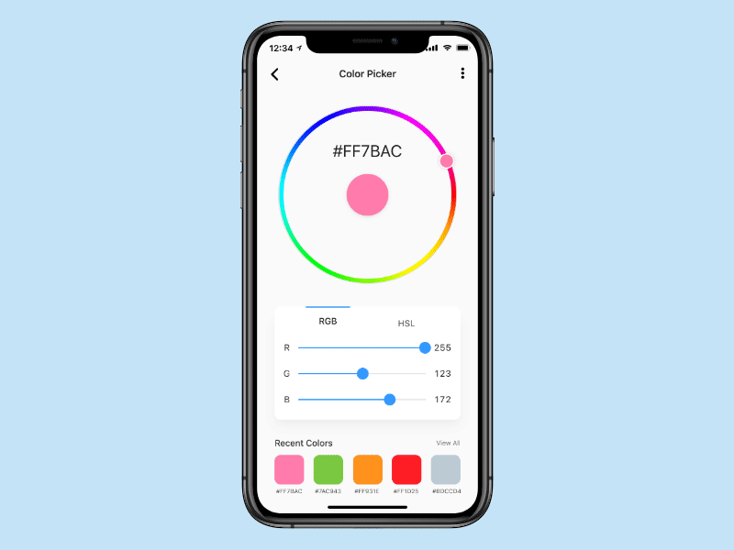
Norman’s Seven Fundamental Design Principles
6. Mapping
The relationship between controls and their effect on the world.

Slide 25
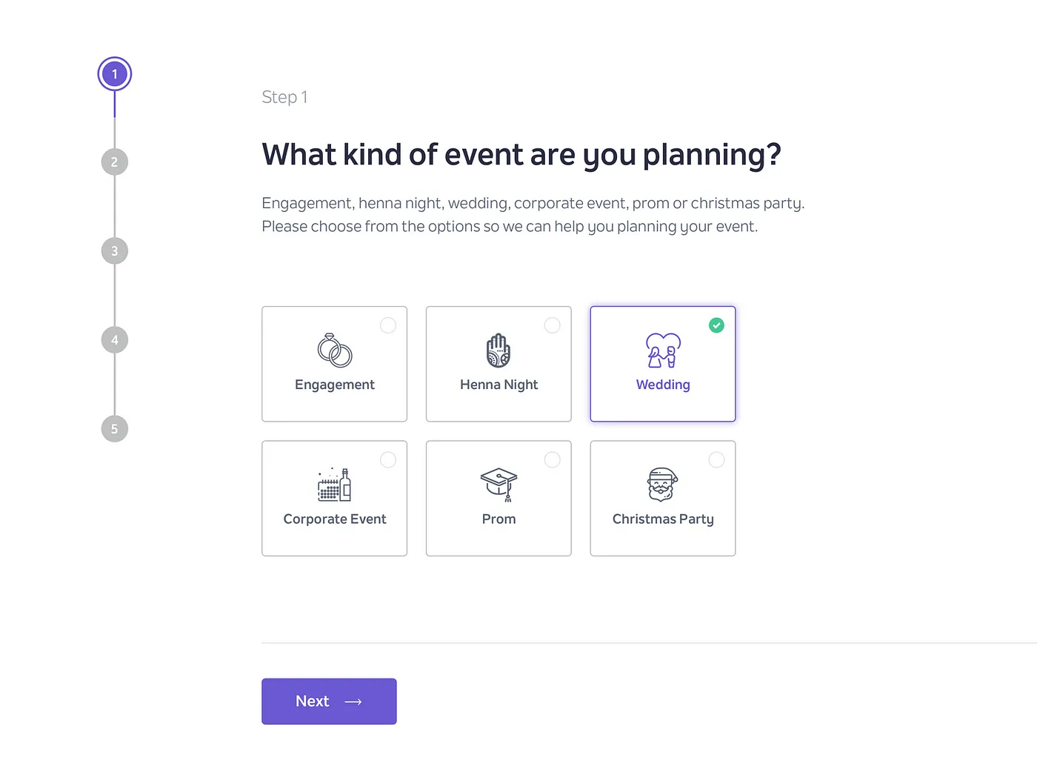
Norman’s Seven Fundamental Design Principles
7. Constraints
Small steps provide users with enough information to complete one task at a time.

Slide 26
https://morioh.com/a/42dc6d4ad6a5/user-interface-design-ui-in-software-engineering
https://www.uxmatters.com/mt/archives/2022/10/applying-the-8-golden-rules-of-user-interface-design.php
https://yellowchalk.com/blog/8-golden-rules-of-interface-design/
https://www.linkedin.com/pulse/creating-consistency-ui-design-manjesh-yadav-
https://www.chameleon.io/inspiration/slack-product-tour-tooltips
Skyscanner | Find the cheapest flights fast: save time, save money!
Don Norman's seven fundamental design principles | UX Collective (uxdesign.cc)
References

